Slide 1
Integration Stretch
My idea.

Slide 2
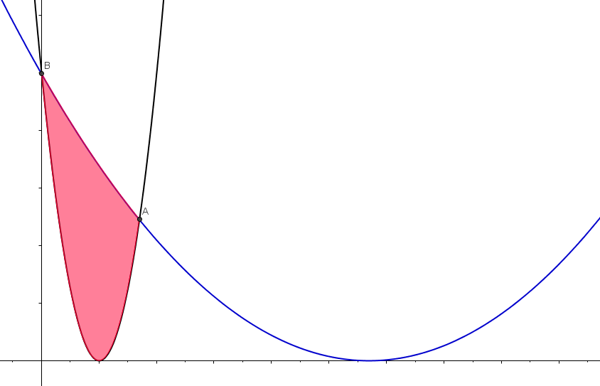
Integration Stretch
y
NOT TO SCALE
f (x), a parabola
16
What stretch factor, k, gives the area stated?
32
g(x) ,
defined by a stretch, parallel to x-axis, of f (x)
0
4
x

Slide 3
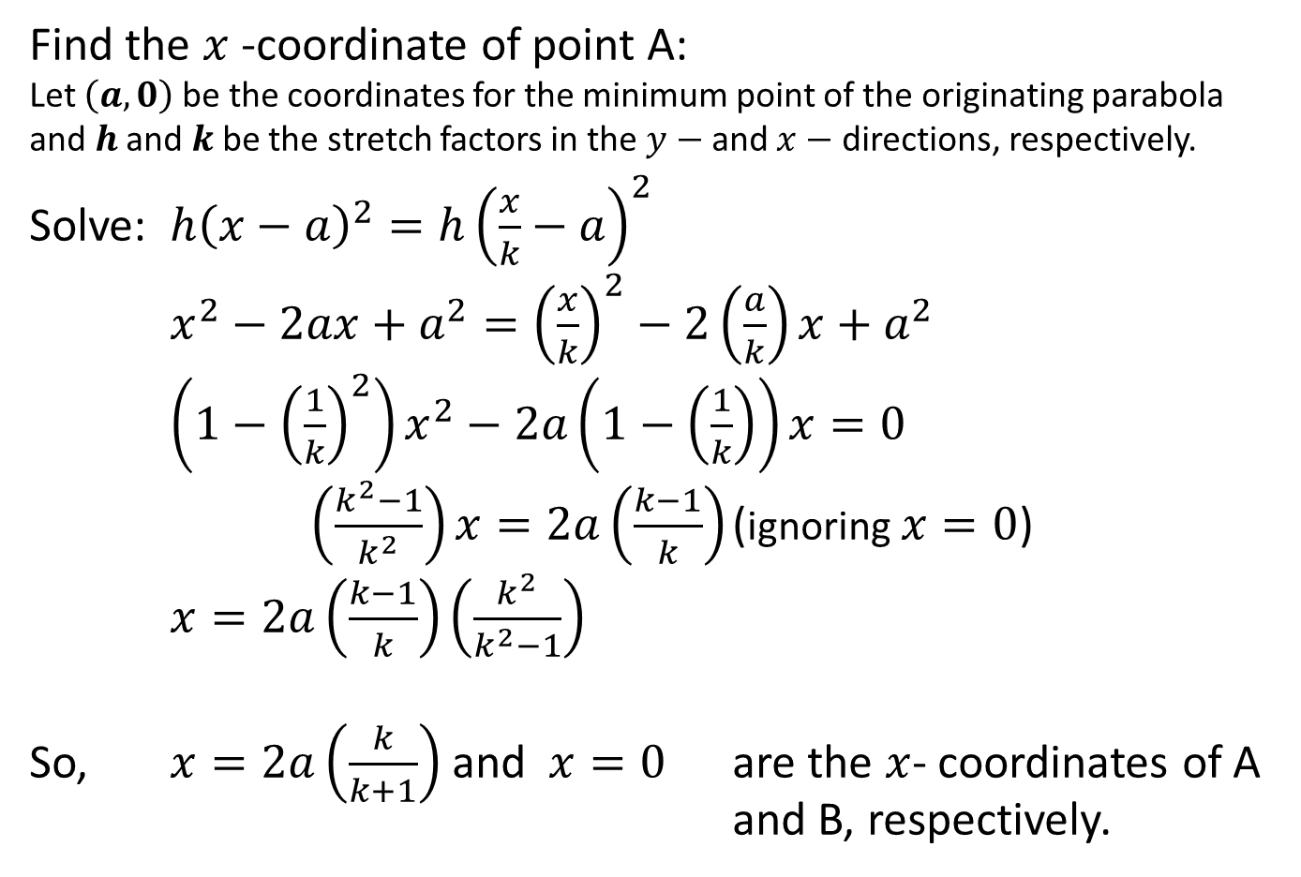
General Solution
Find the $x$-coordinate of point A:
Let $\left(a,0\right)$ be the coordinates for the minimum point of the originating parabola and $h$ and $k$ be the stretch factors in the $y−$ and $x−$ directions, respectively.
Solve: ${h\left(x−a\right)}^{2}={h\left(\frac{x}{k}−a\right)}^{2}$
$x^{2}−2ax+a^{2}={\left(\frac{x}{k}\right)}^{2}−2\left(\frac{a}{k}\right)x+a^{2}$
$\left(1−{\left(\frac{1}{k}\right)}^{2}\right)x^{2}−2a\left(1−\left(\frac{1}{k}\right)\right)x=0$
$\left(\frac{k^{2}−1}{k^{2}}\right)x=2a\left(\frac{k−1}{k}\right)$ (ignoring $x=0$)
$x=2a\left(\frac{k−1}{k}\right)\left(\frac{k^{2}}{k^{2}−1}\right)$
So, $x=2a\left(\frac{k}{k+1}\right)$ and $x=0$ are the $x$- coordinates of A and B, respectively.

Slide 4
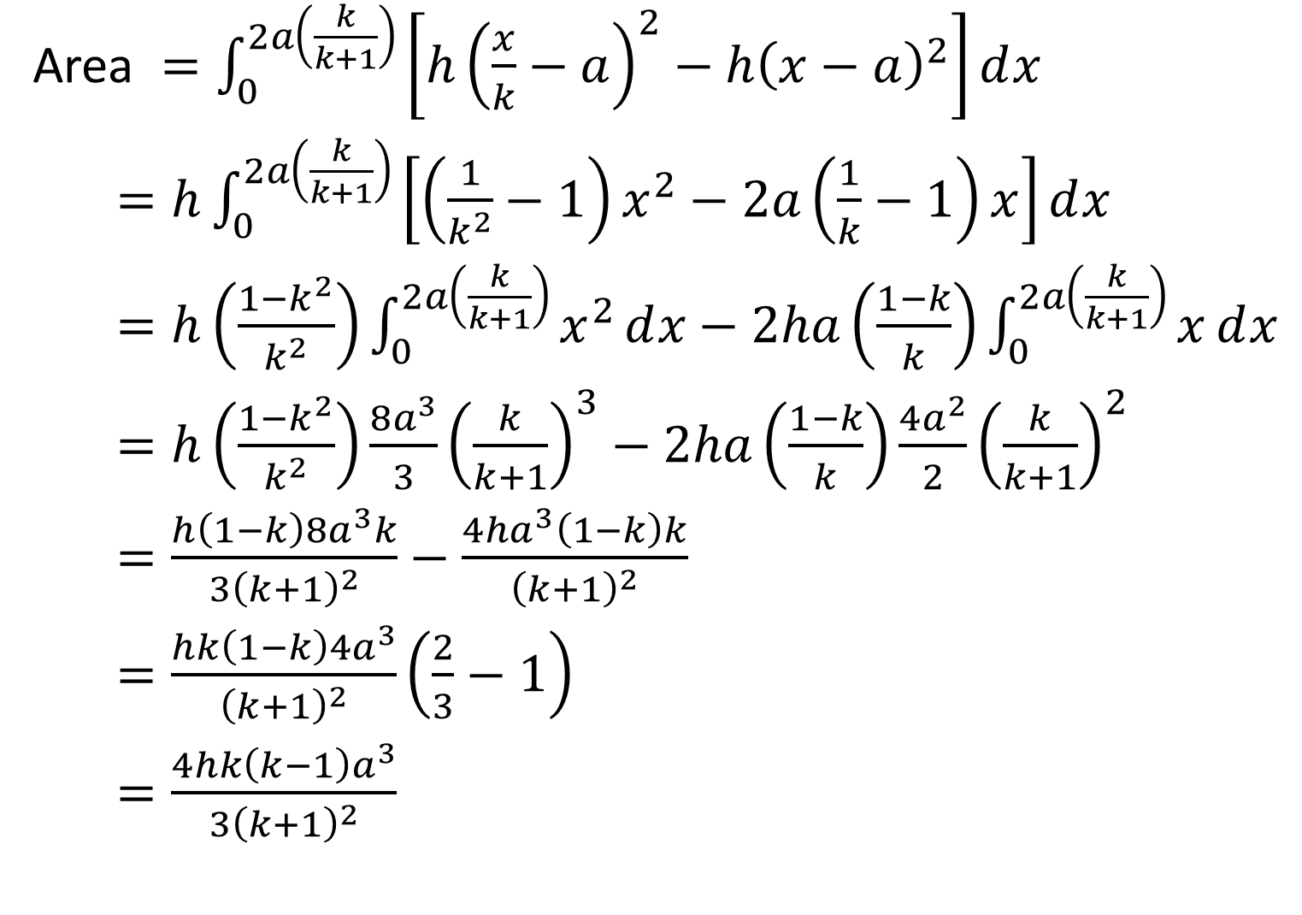
Area $=\int_{0}^{2a\left(\frac{k}{k+1}\right)}{\left[h{\left(\frac{x}{k}−a\right)}^{2}−h{\left(x−a\right)}^{2}\right]ⅆx}$
$=h\int_{0}^{2a\left(\frac{k}{k+1}\right)}{\left[\left(\frac{1}{k^{2}}−1\right)x^{2}−2a\left(\frac{1}{k}−1\right)x\right]ⅆx}$
$=h\left(\frac{1−k^{2}}{k^{2}}\right)\int_{0}^{2a\left(\frac{k}{k+1}\right)}{x^{2}ⅆx}−2ha\left(\frac{1−k}{k}\right)\int_{0}^{2a\left(\frac{k}{k+1}\right)}{xⅆx}$
$=h\left(\frac{1−k^{2}}{k^{2}}\right)\frac{8a^{3}}{3}{\left(\frac{k}{k+1}\right)}^{3}−2ha\left(\frac{1−k}{k}\right)\frac{4a^{2}}{2}{\left(\frac{k}{k+1}\right)}^{2}$
$=\frac{h\left(1−k\right)8a^{3}k}{3{\left(k+1\right)}^{2}}−\frac{4ha^{3}\left(1−k\right)k}{{\left(k+1\right)}^{2}}$
$=\frac{hk\left(1−k\right)4a^{3}}{{\left(k+1\right)}^{2}}\left(\frac{2}{3}−1\right)$
$=\frac{4hk\left(k−1\right)a^{3}}{{3\left(k+1\right)}^{2}}$

Slide 5
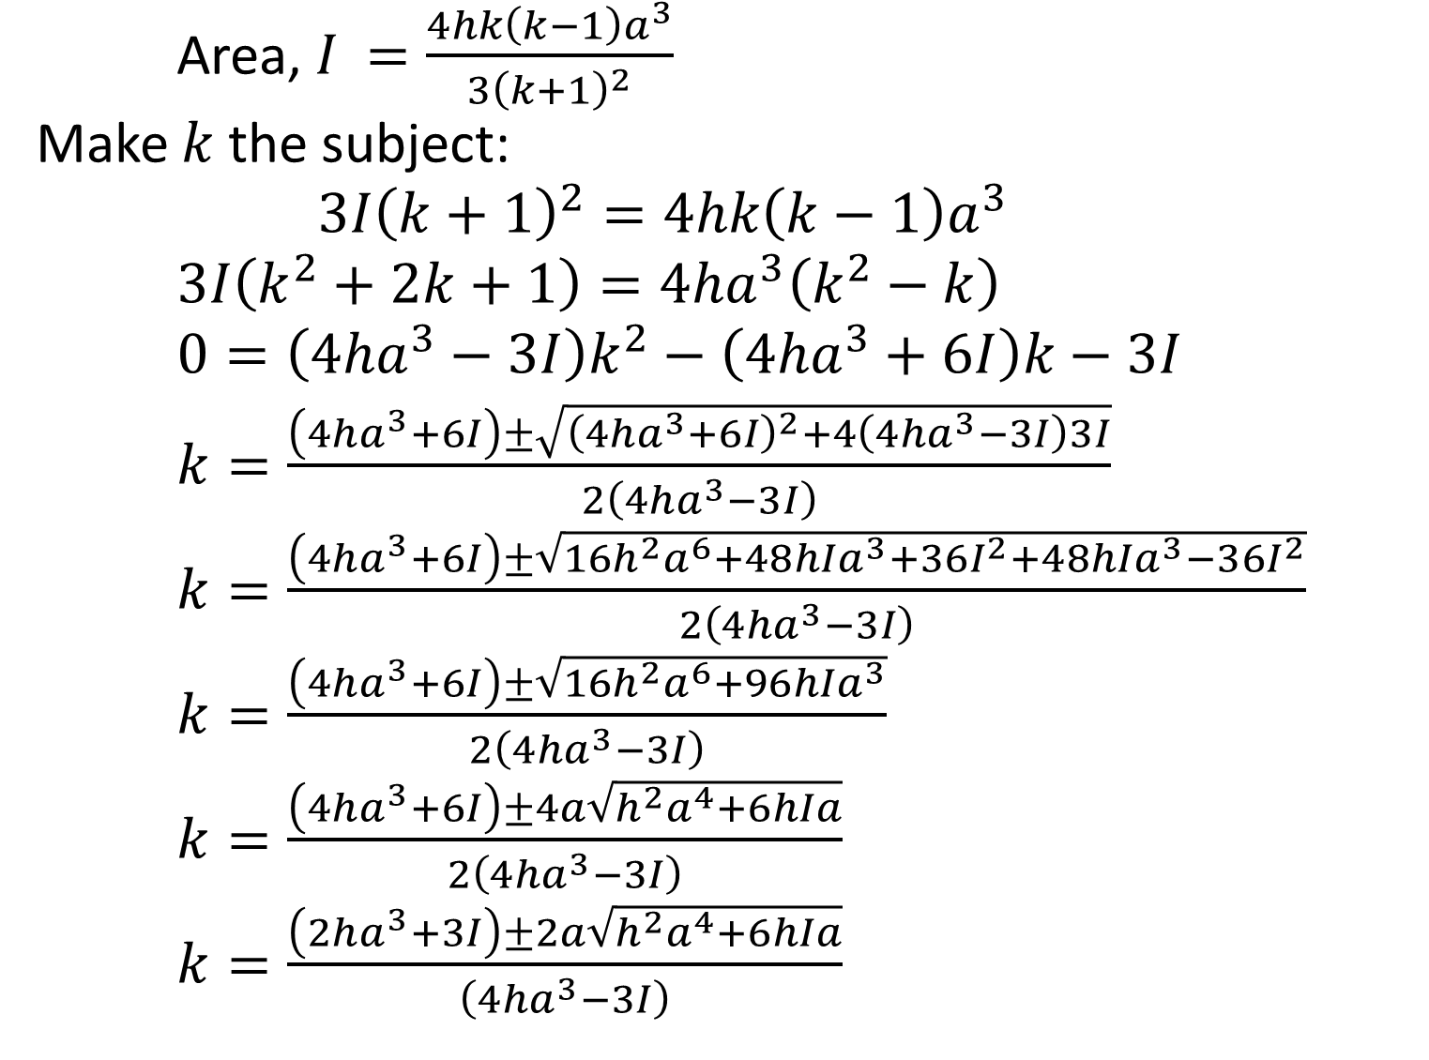
Area, $I$ $=\frac{4hk\left(k−1\right)a^{3}}{3{\left(k+1\right)}^{2}}$
Make $k$ the subject:
$3I{\left(k+1\right)}^{2}=4hk\left(k−1\right)a^{3}$
$3I\left(k^{2}+2k+1\right)=4ha^{3}\left(k^{2}−k\right)$
$0=\left(4ha^{3}−3I\right)k^{2}−\left(4ha^{3}+6I\right)k−3I$
$k=\frac{\left(4ha^{3}+6I\right)±\sqrt{{\left(4ha^{3}+6I\right)}^{2}+4\left(4ha^{3}−3I\right)3I}}{2\left(4ha^{3}−3I\right)}$
$k=\frac{\left(4ha^{3}+6I\right)±\sqrt{16h^{2}a^{6}+48hIa^{3}+36I^{2}+48hIa^{3}−36I^{2}}}{2\left(4ha^{3}−3I\right)}$
$k=\frac{\left(4ha^{3}+6I\right)±\sqrt{16h^{2}a^{6}+96hIa^{3}}}{2\left(4ha^{3}−3I\right)}$
$k=\frac{\left(4ha^{3}+6I\right)±4a\sqrt{{h^{2}a}^{4}+6hIa}}{2\left(4ha^{3}−3I\right)}$
$k=\frac{\left(2ha^{3}+3I\right)±2a\sqrt{{h^{2}a}^{4}+6hIa}}{\left(4ha^{3}−3I\right)}$

Slide 6
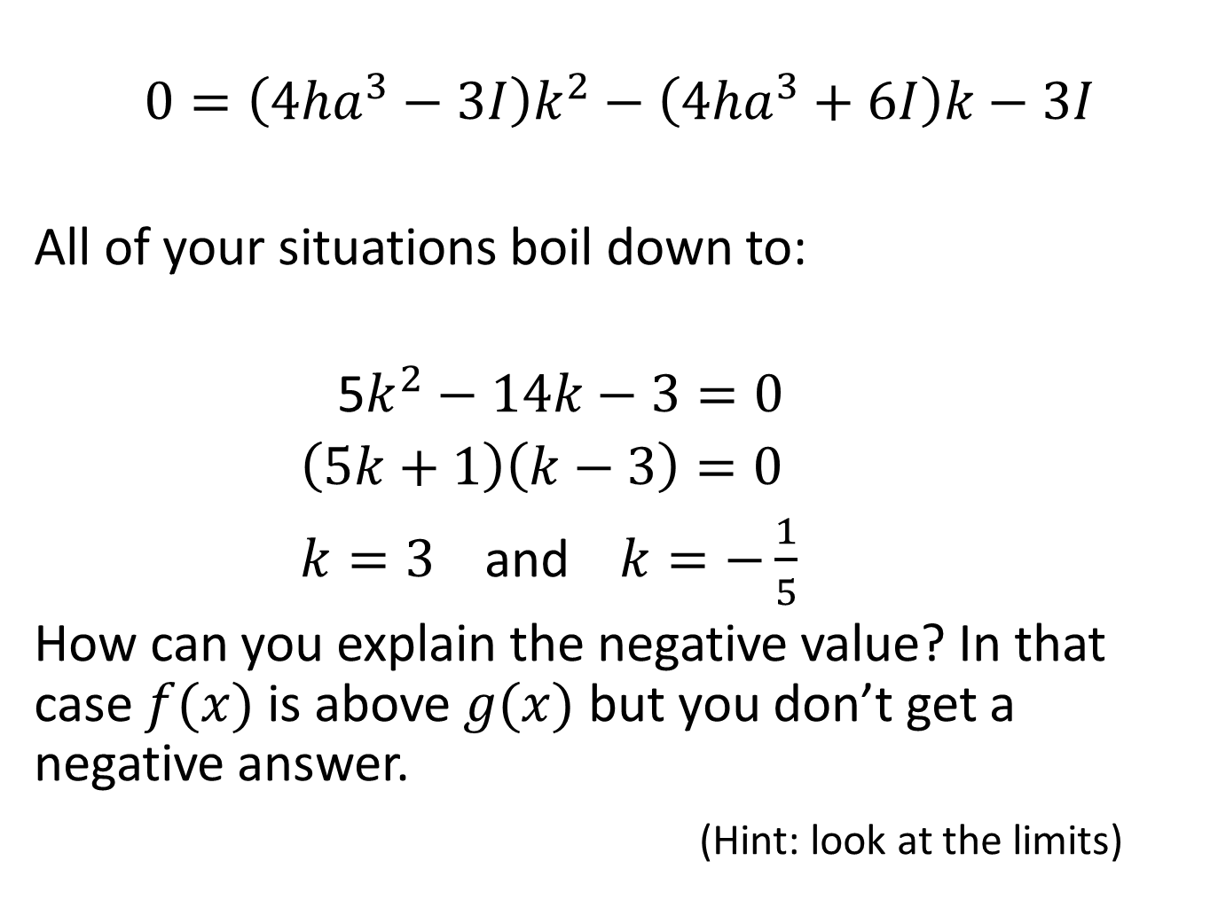
$$0=\left(4ha^{3}−3I\right)k^{2}−\left(4ha^{3}+6I\right)k−3I$$
All of your situations boil down to:
5$k^{2}−14k−3=0$
$\left(5k+1\right)\left(k−3\right)=0$
$k=3$ and $k=−\frac{1}{5}$
How can you explain the negative value? In that case $f(x)$ is above $g(x)$ but you don’t get a negative answer.
(Hint: look at the limits)

Slide 8
Worked Solutions follow
You can show each one in this Powerpoint or use the Integration Stretch Working Geogebra file.
There is also a PDF with all the working for all of the worksheets.
You can decide which route to follow.

Slide 9
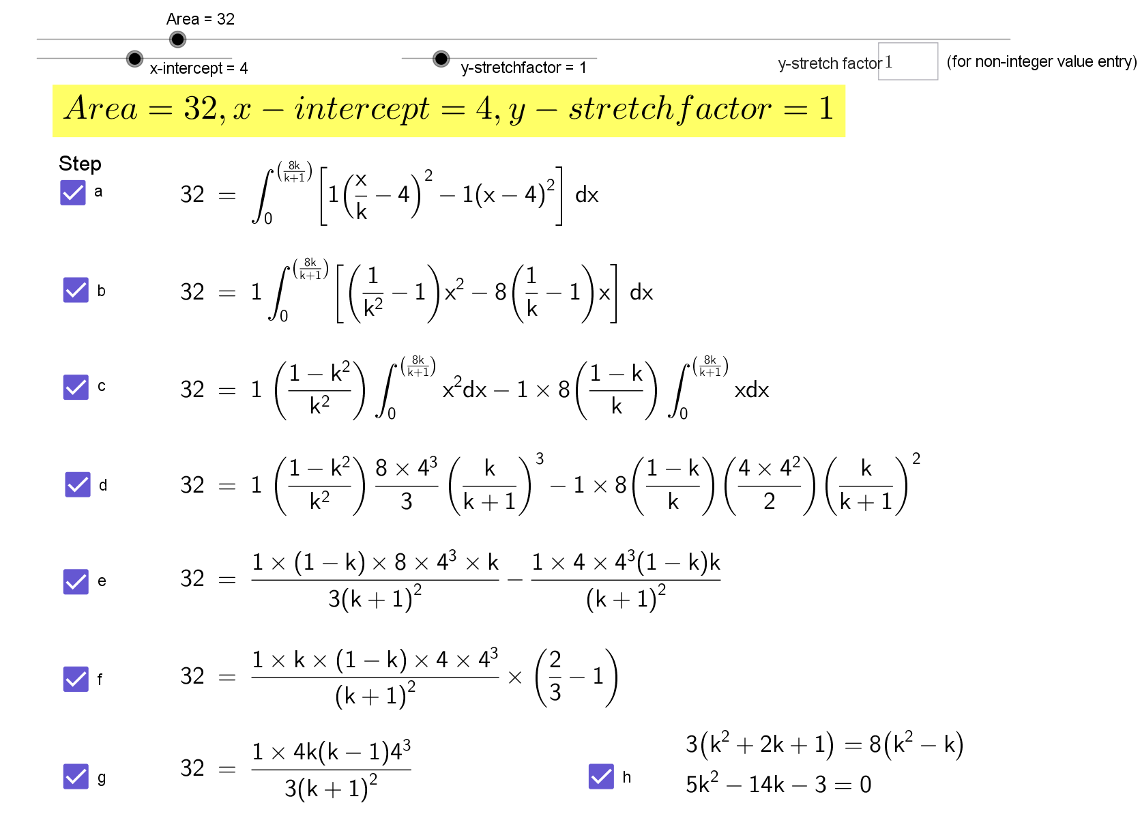

Slide 10
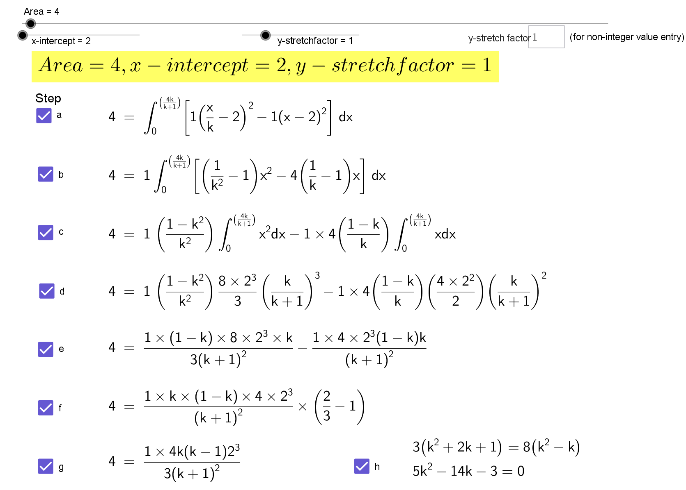

Slide 11
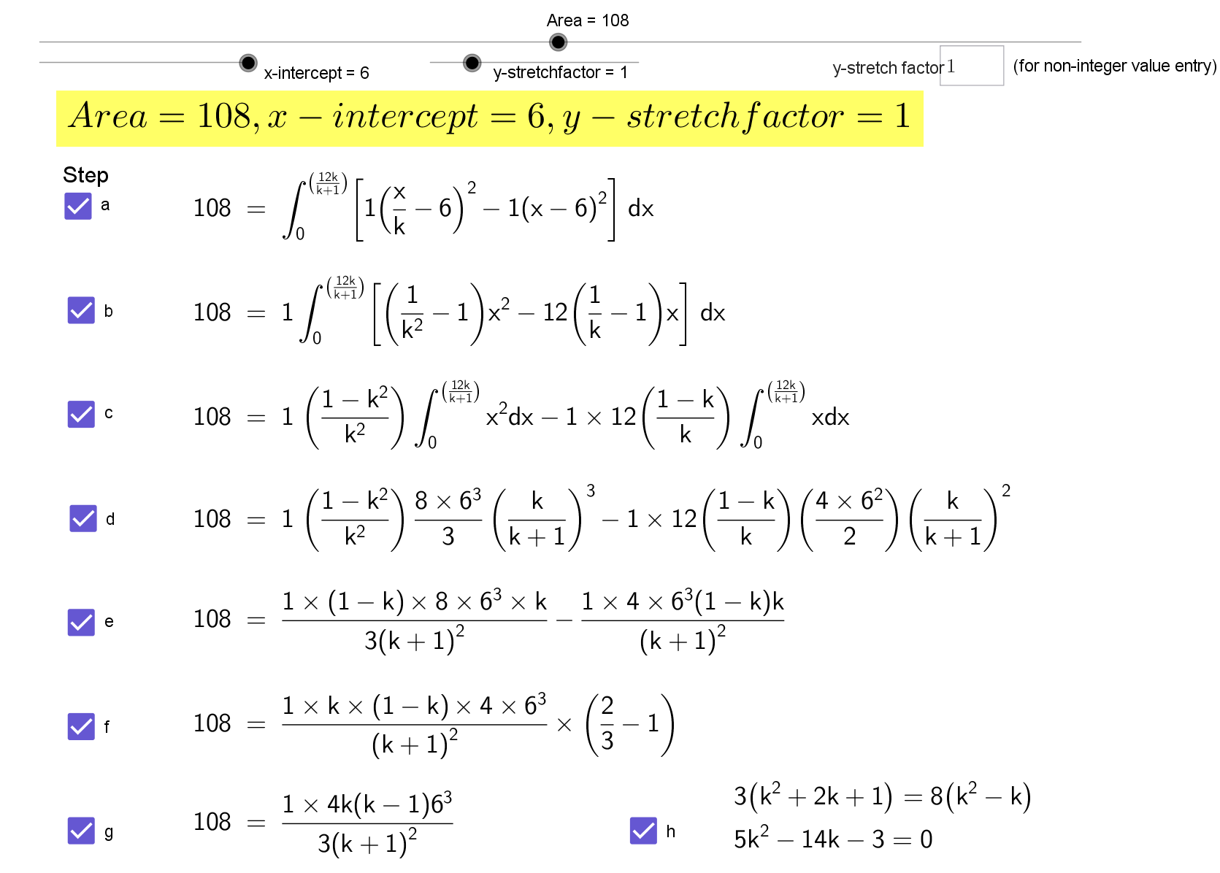

Slide 12
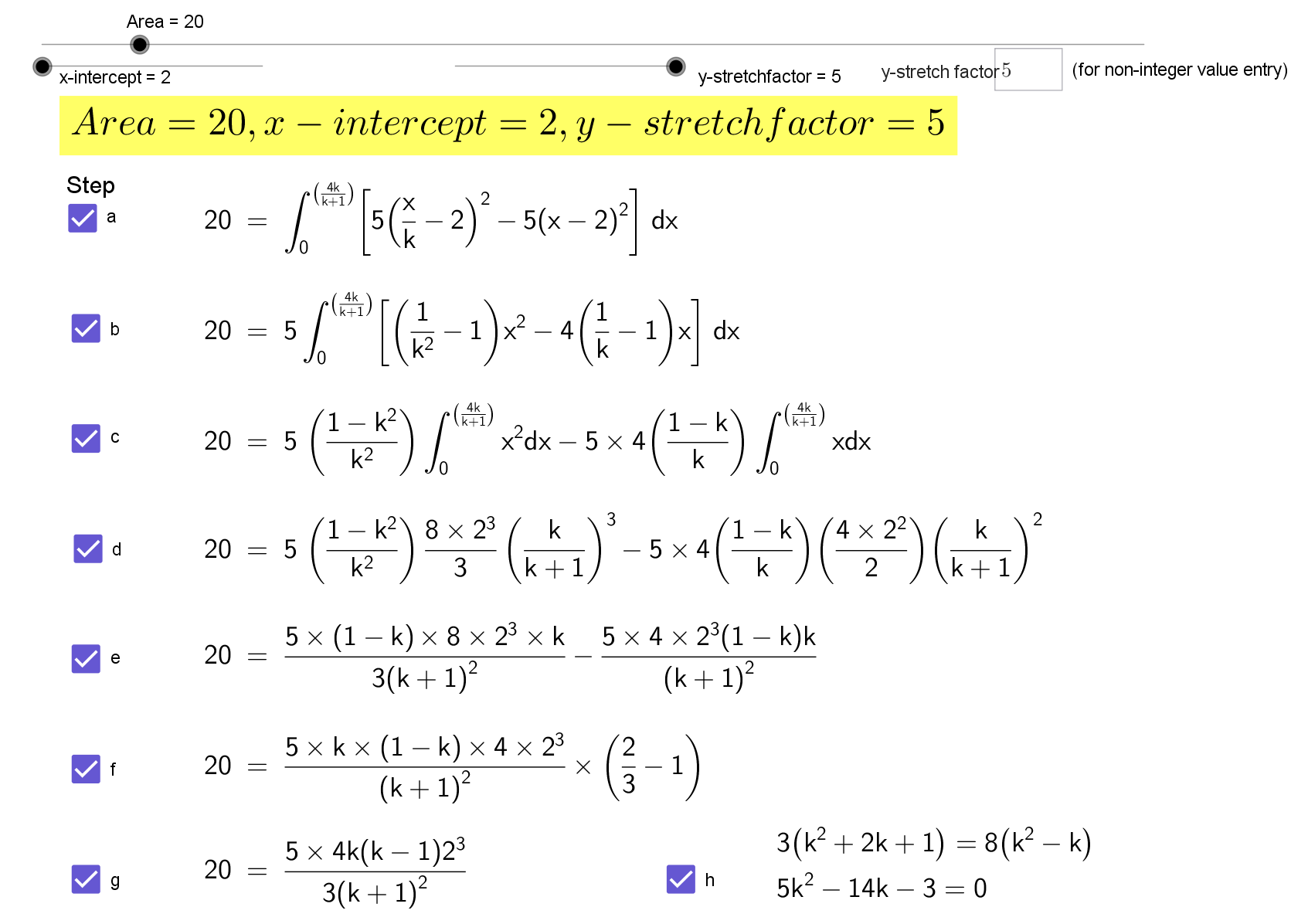

Slide 13
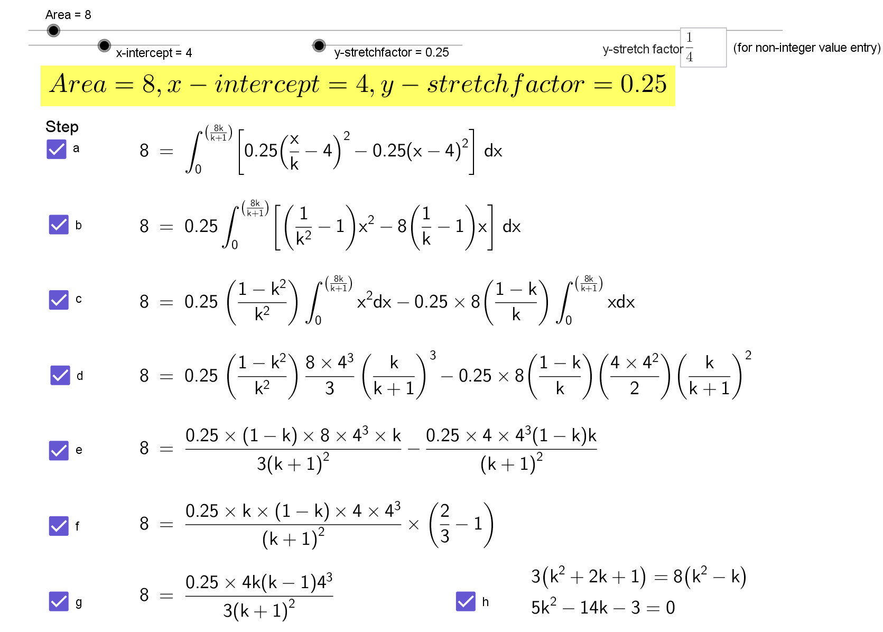

Slide 14
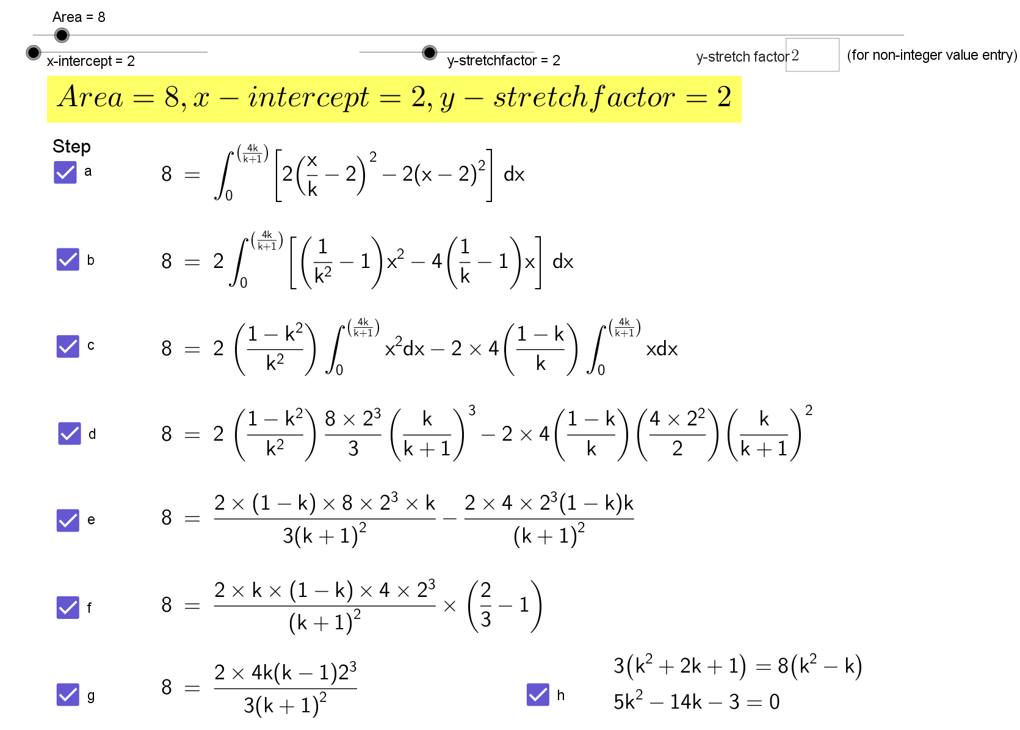

Slide 15
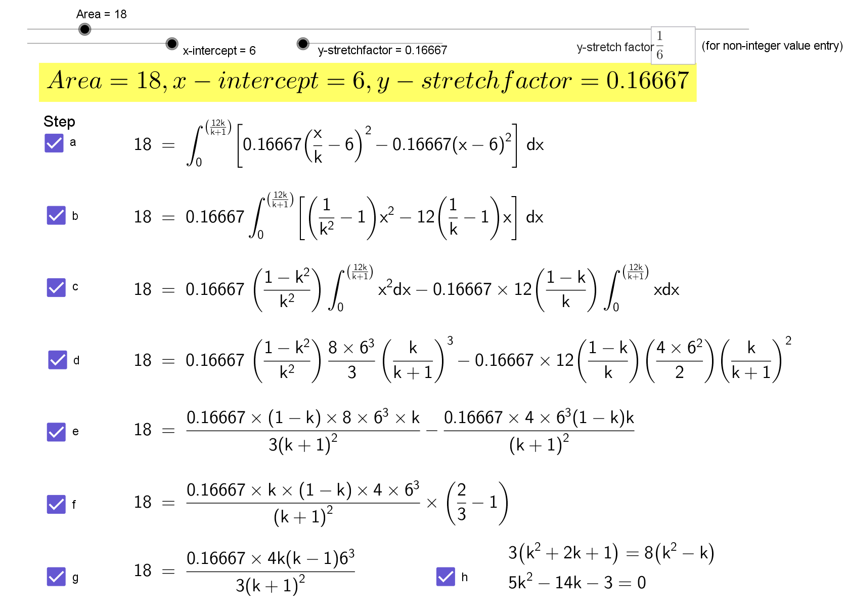

Slide 16
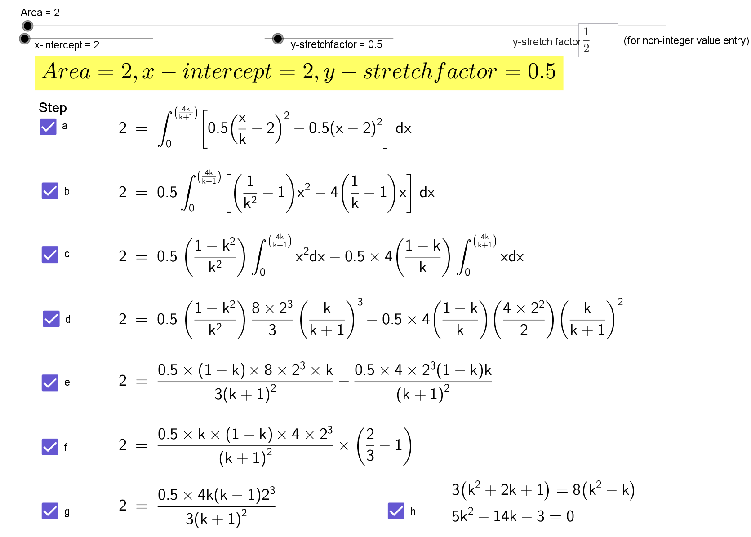

Slide 17
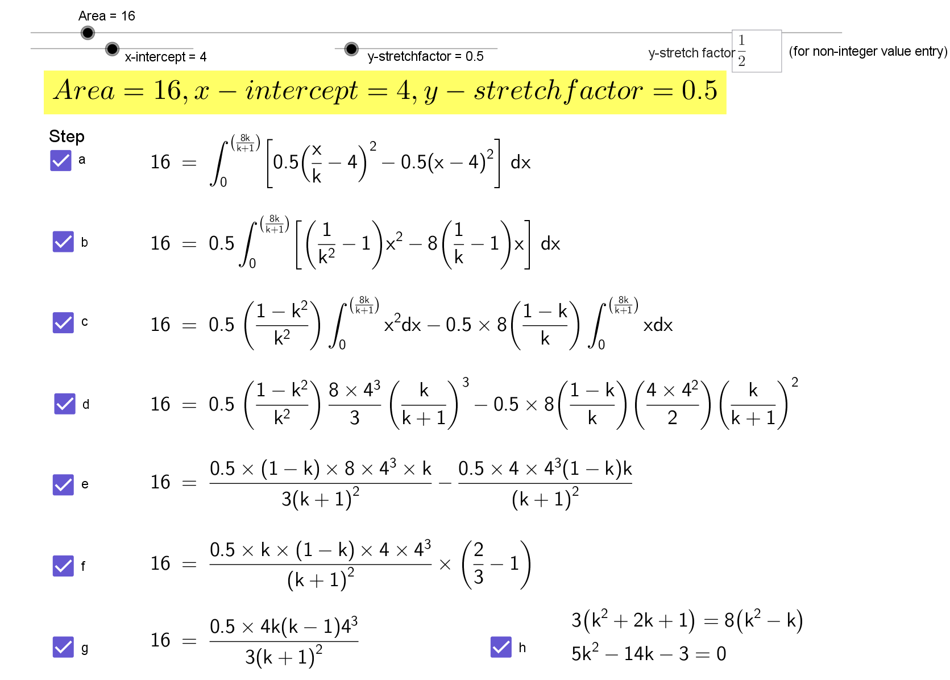

Slide 18
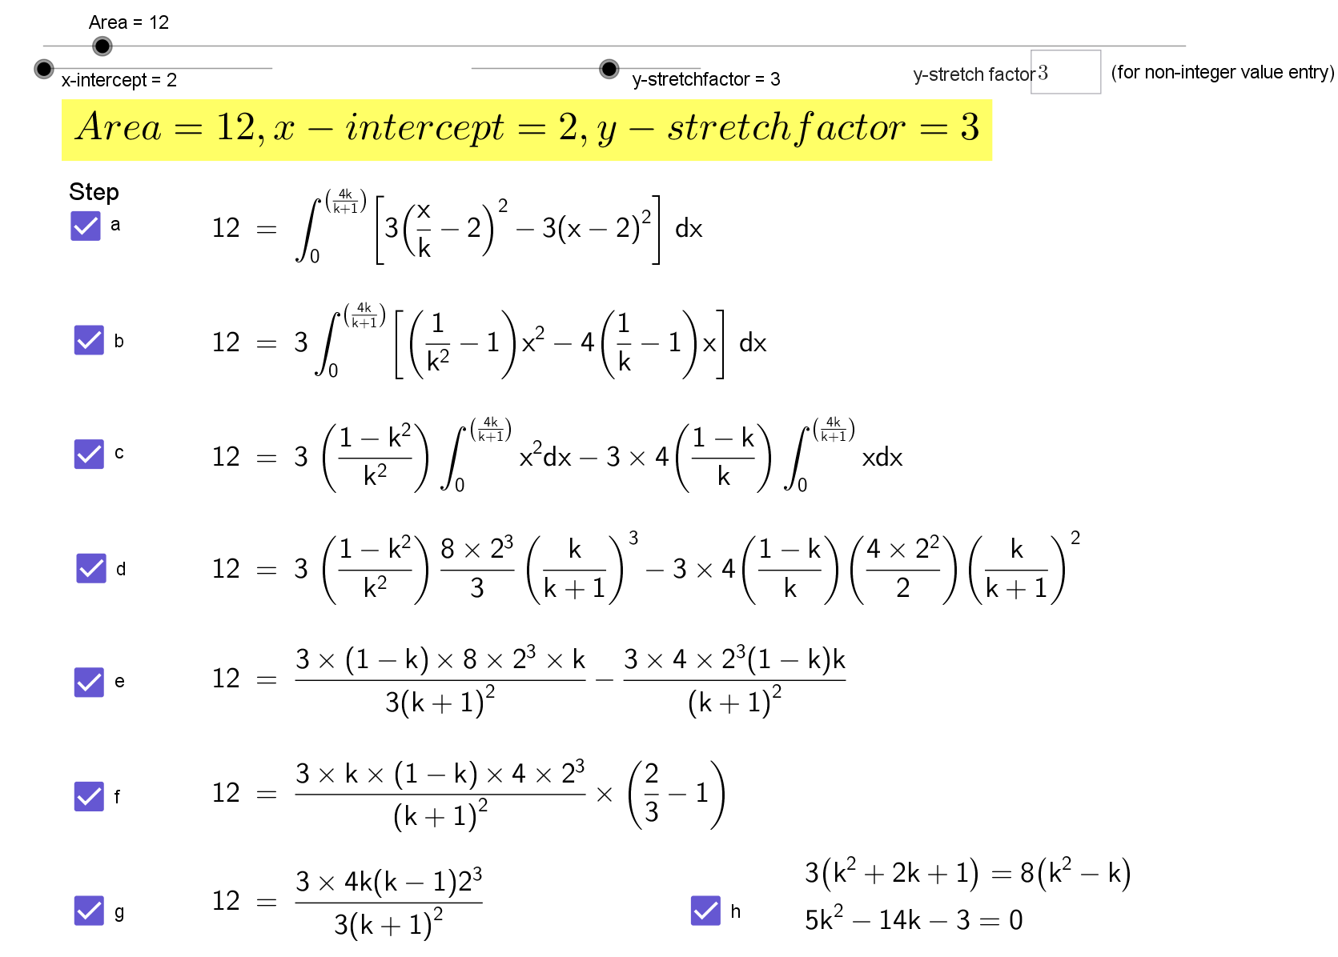

Slide 19
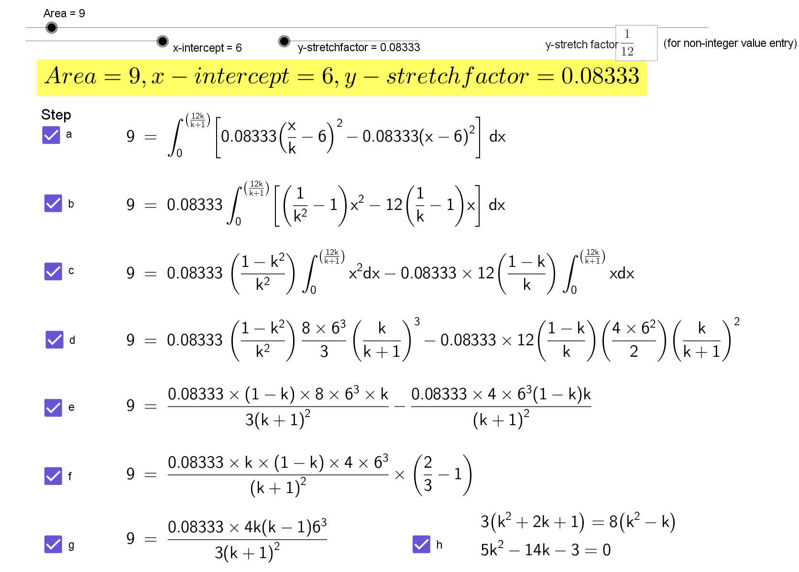

Slide 20
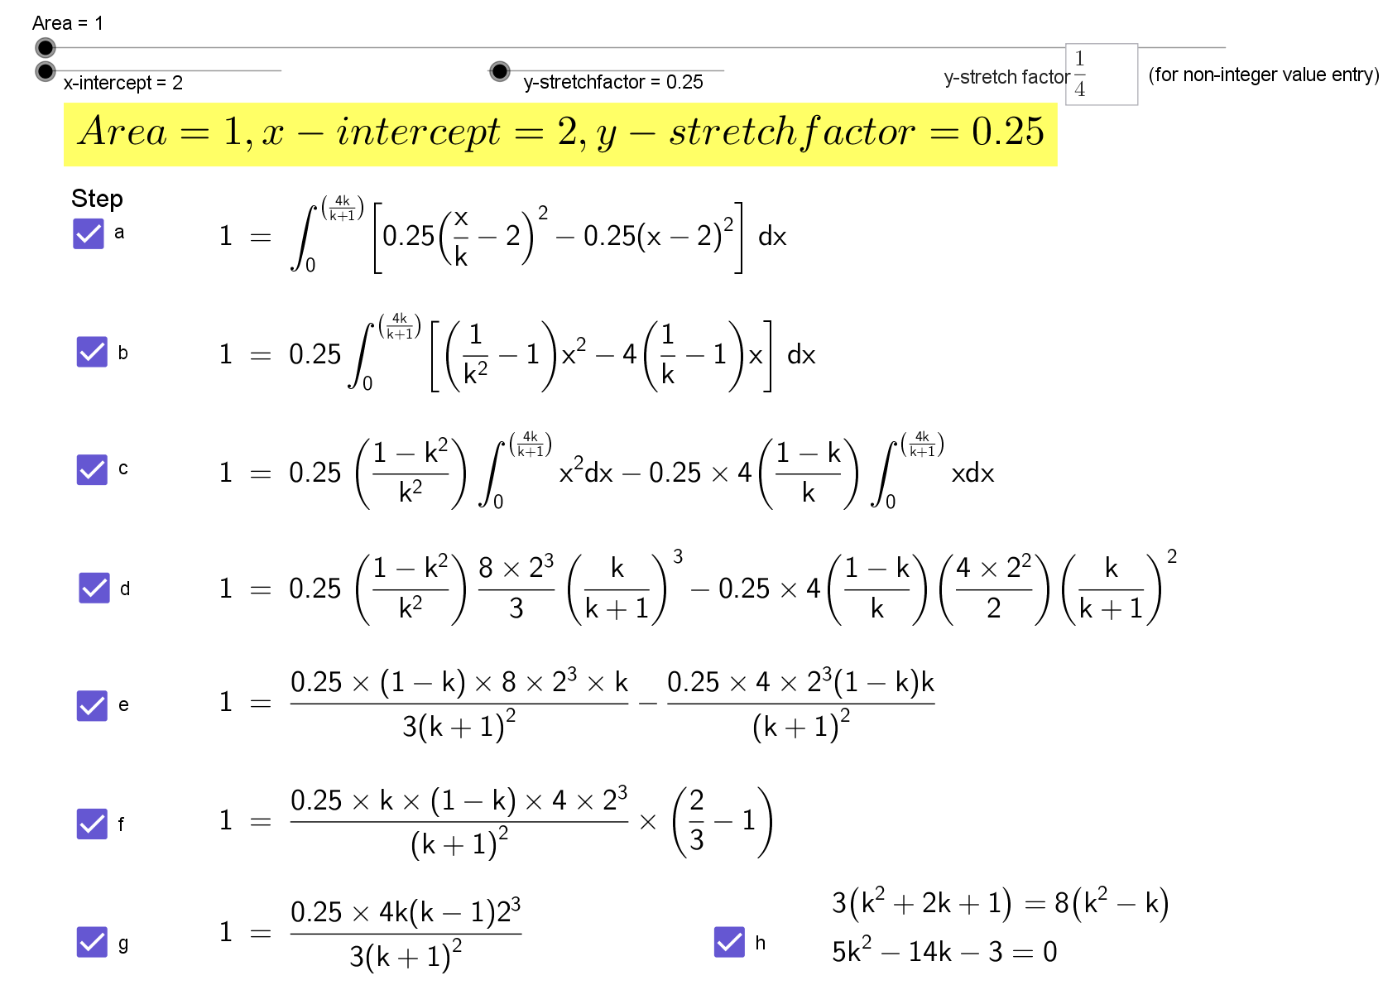

Slide 21
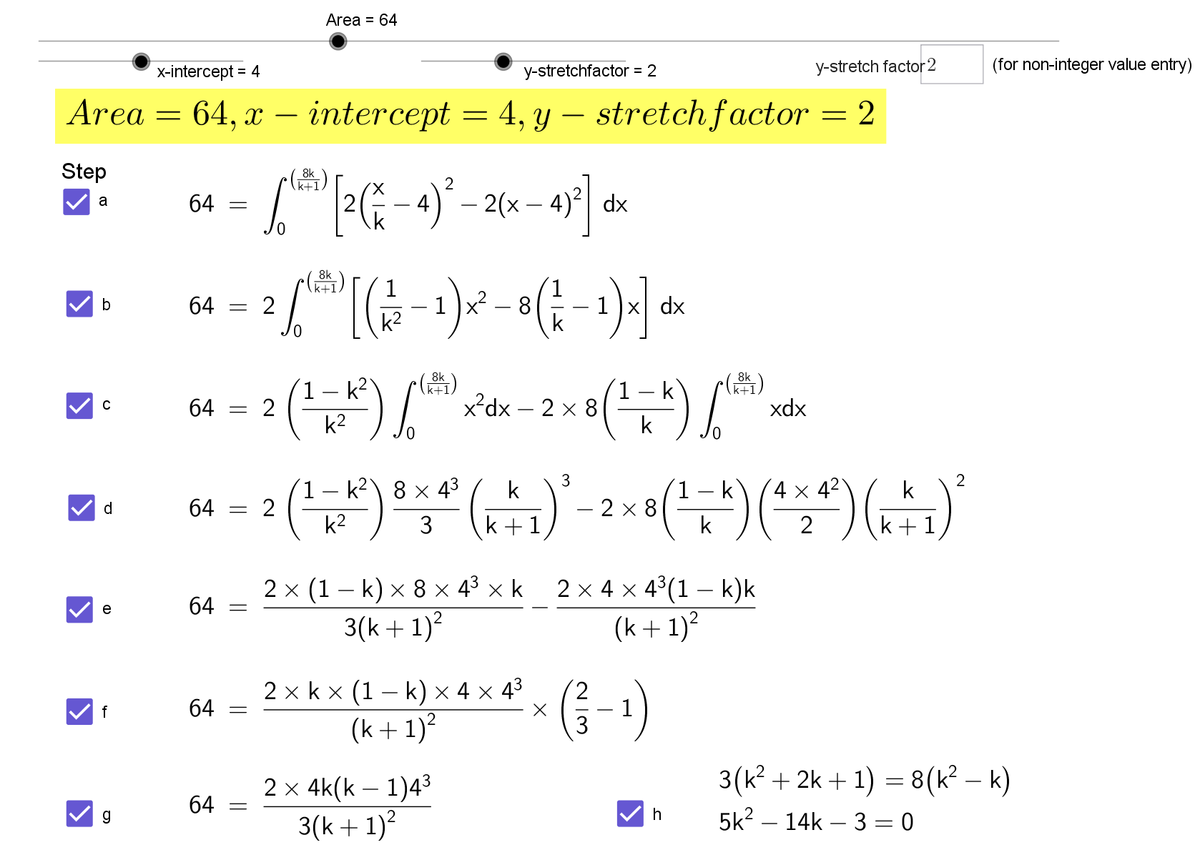

Slide 22


Slide 23


Slide 24
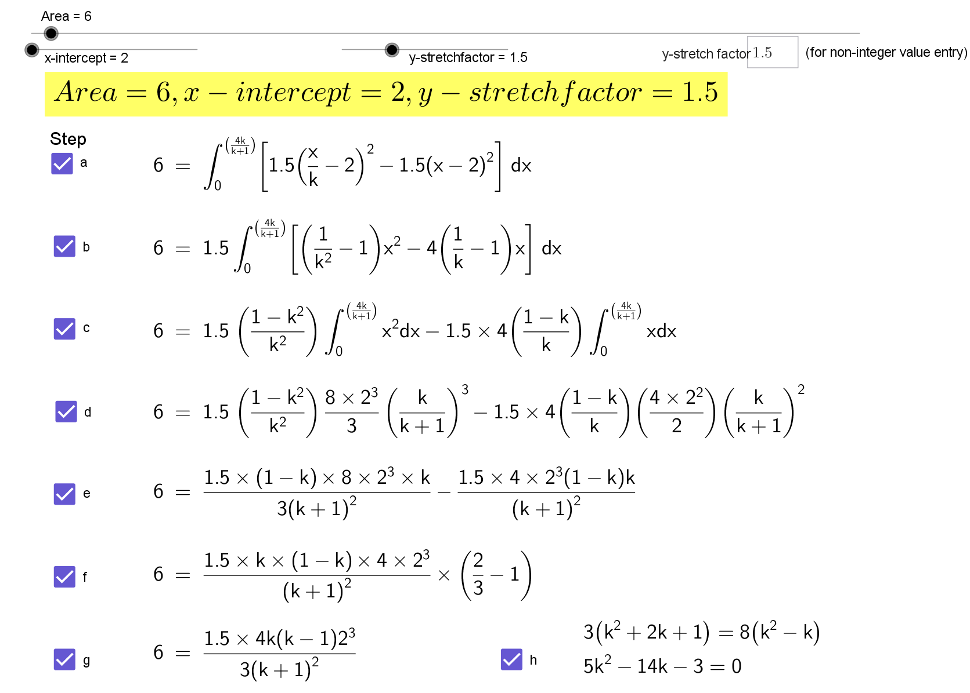

Slide 25
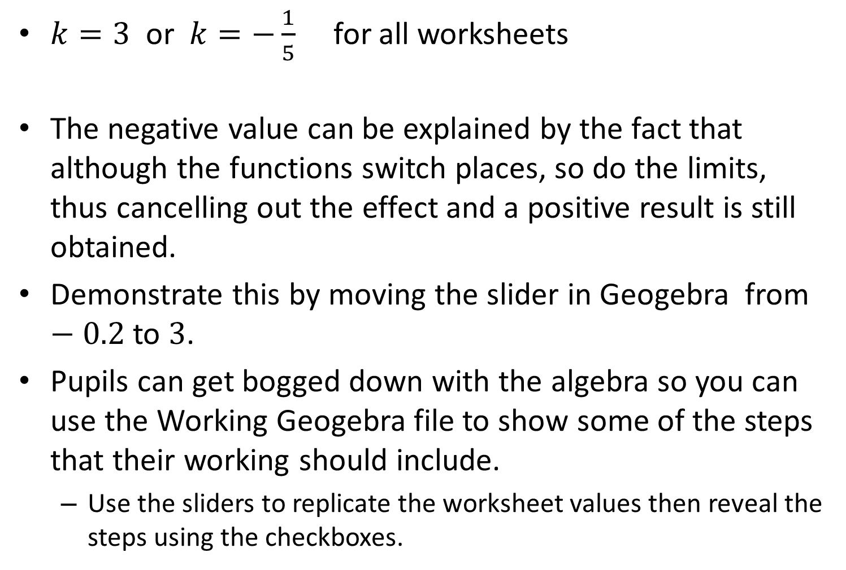
Note to teacher
$k=3$ or $k=−\frac{1}{5}$ for all worksheets
The negative value can be explained by the fact that although the functions switch places, so do the limits, thus cancelling out the effect and a positive result is still obtained.
Demonstrate this by moving the slider in Geogebra from $−0.2$ to $3$.
Pupils can get bogged down with the algebra so you can use the Working Geogebra file to show some of the steps that their working should include.
Use the sliders to replicate the worksheet values then reveal the steps using the checkboxes.

Slide 26
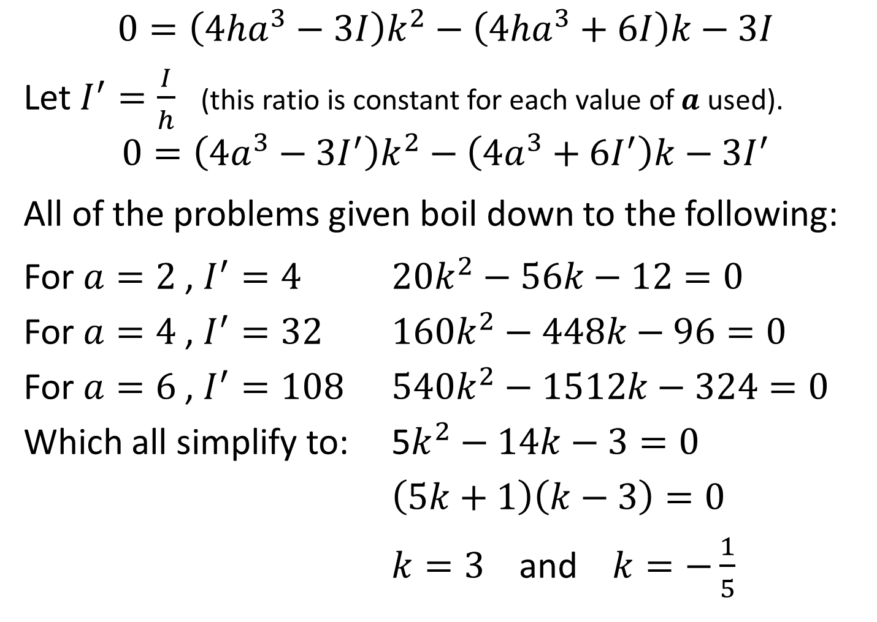
$$0=\left(4ha^{3}−3I\right)k^{2}−\left(4ha^{3}+6I\right)k−3I$$
Let $I^{′}=\frac{I}{h}$ (this ratio is constant for each value of $a$ used).
$$0=\left(4a^{3}−3I^{′}\right)k^{2}−\left(4a^{3}+6I^{′}\right)k−3I^{′}$$
All of the problems given boil down to the following:
For $a=2$ , $I^{′}=4$ $20k^{2}−56k−12=0$
For $a=4$ , $I^{′}=32$ $160k^{2}−448k−96=0$
For $a=6$ , $I^{′}=108$ $540k^{2}−1512k−324=0$
Which all simplify to: 5$k^{2}−14k−3=0$
$\left(5k+1\right)\left(k−3\right)=0$
$k=3$ and $k=−\frac{1}{5}$

Slide 27
Resources

Slide 28
Integration Stretch
y
NOT TO SCALE
f (x), a parabola
16
What stretch factor, k, gives the area stated?
32
g(x) ,
defined by a stretch, parallel to x-axis, of f (x)
0
4
x
SIC_14

Slide 29
Integration Stretch
y
NOT TO SCALE
f (x), a parabola
4
What stretch factor, k, gives the area stated?
4
g(x) ,
defined by a stretch, parallel to x-axis, of f (x)
0
2
x
SIC_14

Slide 30
Integration Stretch
y
NOT TO SCALE
f (x), a parabola
36
What stretch factor, k, gives the area stated?
108
g(x) ,
defined by a stretch, parallel to x-axis, of f (x)
0
6
x
SIC_14

Slide 31
Integration Stretch
y
NOT TO SCALE
f (x), a parabola
20
What stretch factor, k, gives the area stated?
20
g(x) ,
defined by a stretch, parallel to x-axis, of f (x)
0
2
x
SIC_14

Slide 32
Integration Stretch
y
NOT TO SCALE
f (x), a parabola
4
What stretch factor, k, gives the area stated?
8
g(x) ,
defined by a stretch, parallel to x-axis, of f (x)
0
4
x
SIC_14

Slide 33
Integration Stretch
y
NOT TO SCALE
f (x), a parabola
8
What stretch factor, k, gives the area stated?
8
g(x) ,
defined by a stretch, parallel to x-axis, of f (x)
0
2
x
SIC_14

Slide 34
Integration Stretch
y
NOT TO SCALE
f (x), a parabola
6
What stretch factor, k, gives the area stated?
18
g(x) ,
defined by a stretch, parallel to x-axis, of f (x)
0
6
x
SIC_14

Slide 35
Integration Stretch
y
NOT TO SCALE
f (x), a parabola
2
What stretch factor, k, gives the area stated?
2
g(x) ,
defined by a stretch, parallel to x-axis, of f (x)
0
2
x
SIC_14

Slide 36
Integration Stretch
y
NOT TO SCALE
f (x), a parabola
8
What stretch factor, k, gives the area stated?
16
g(x) ,
defined by a stretch, parallel to x-axis, of f (x)
0
4
x
SIC_14

Slide 37
Integration Stretch
y
NOT TO SCALE
f (x), a parabola
12
What stretch factor, k, gives the area stated?
12
g(x) ,
defined by a stretch, parallel to x-axis, of f (x)
0
2
x
SIC_14

Slide 38
Integration Stretch
y
NOT TO SCALE
f (x), a parabola
3
What stretch factor, k, gives the area stated?
9
g(x) ,
defined by a stretch, parallel to x-axis, of f (x)
0
6
x
SIC_14

Slide 39
Integration Stretch
y
NOT TO SCALE
f (x), a parabola
1
What stretch factor, k, gives the area stated?
1
g(x) ,
defined by a stretch, parallel to x-axis, of f (x)
0
2
x
SIC_14

Slide 40
Integration Stretch
y
NOT TO SCALE
f (x), a parabola
32
What stretch factor, k, gives the area stated?
64
g(x) ,
defined by a stretch, parallel to x-axis, of f (x)
0
4
x
SIC_14

Slide 41
Integration Stretch
y
NOT TO SCALE
f (x), a parabola
16
What stretch factor, k, gives the area stated?
16
g(x) ,
defined by a stretch, parallel to x-axis, of f (x)
0
2
x
SIC_14

Slide 42
Integration Stretch
y
NOT TO SCALE
f (x), a parabola
1
What stretch factor, k, gives the area stated?
3
g(x) ,
defined by a stretch, parallel to x-axis, of f (x)
0
6
x
SIC_14

Slide 43
Integration Stretch
y
NOT TO SCALE
f (x), a parabola
6
What stretch factor, k, gives the area stated?
6
g(x) ,
defined by a stretch, parallel to x-axis, of f (x)
0
2
x
SIC_14

